Slide 1
100 Largest Companies by Revenue in the United States for 2022
Coded and presented by Mark Lech

Slide 2
100 Largest Companies by Revenue in the United States for 2022
This tool maps and graphs corporate data in three ways:
A heat map showing the distribution of the largest corporate headquarters across the United States.
2. A bar chart that groups their total revenue by industry.
3. Dynamic line charts of the stock prices for whichever company the user chooses from a dropdown menu.

Slide 3
Input Files
100 rows of company data from "data/largest_us_companies_2022.csv“
Source: Wikipedia - https://en.wikipedia.org/wiki/List_of_largest_companies_in_the_United_States_by_revenue
21,586 rows of historical stock data from "data/stock_prices_2022.csv“
Source: Yahoo! Finance –
https://finance.yahoo.com/lookup
For more info: SLIDESGO | BLOG | FAQs
You can visit our sister projects: FREEPIK | FLATICON | STORYSET | WEPIK | VIDEVO

Slide 4
Key Pieces
1
2
Database
Tables
3
4
Visualizations
APIs
companies
stocks
PostgresSQL
Leaflet Heat Map
Plotly Bar Chart
Plotly Line Chart
companies
industries
names
stock

Slide 5
Technologies
Python Flask-powered APIs
HTML/CSS
JavaScript
Leaflet
Plotly

Slide 6
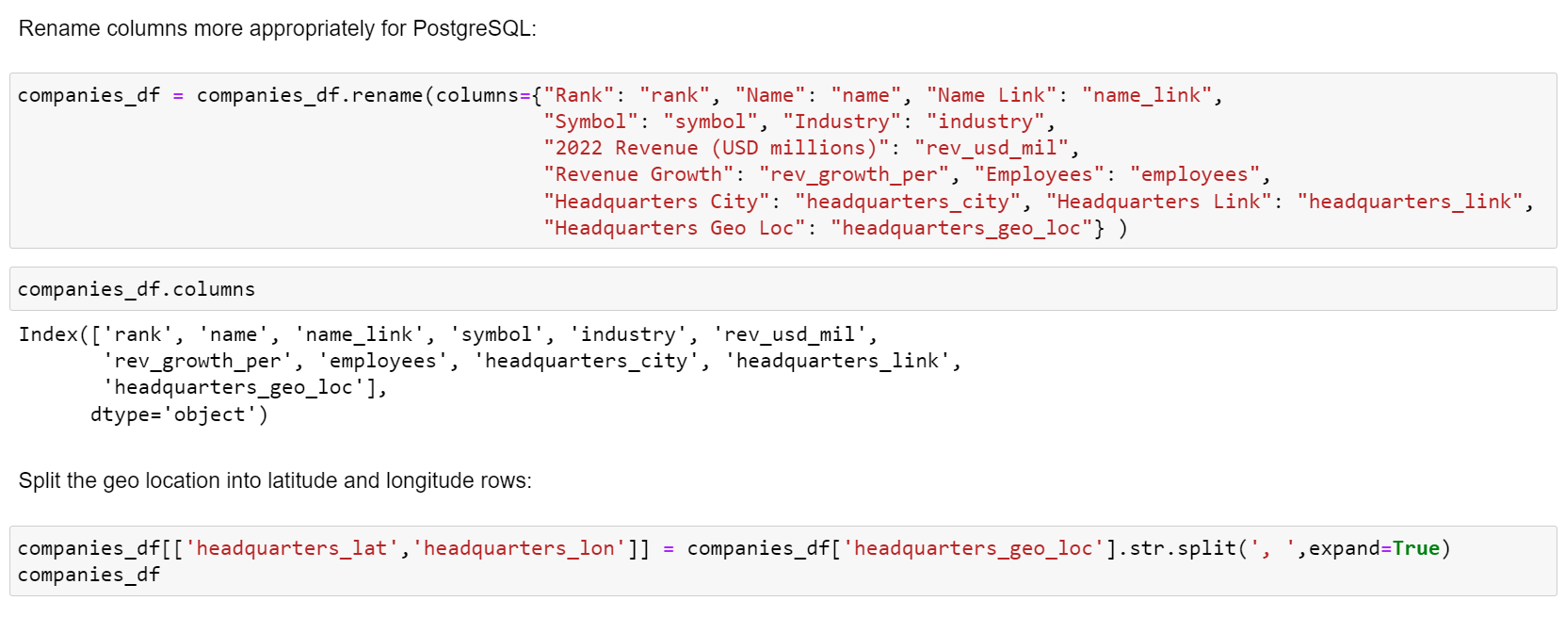
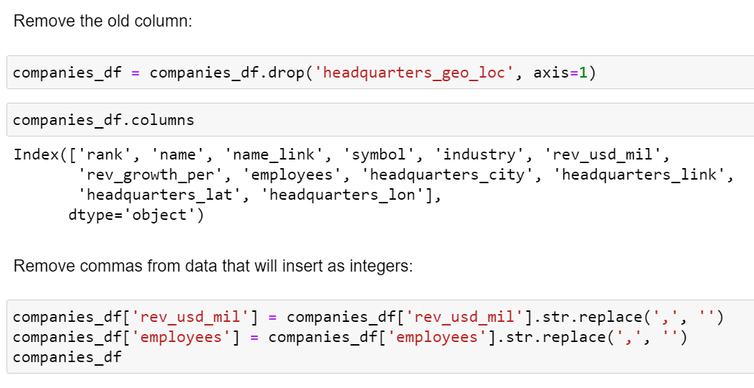
Data
Cleaning
in Jupyter
notebook
Updated column names
Split coordinates into latitude and longitude columns
Removed commas from integer fields

Slide 7


Uploaded
with SQLAlchemy
Database
in PostgreSQL

Slide 8
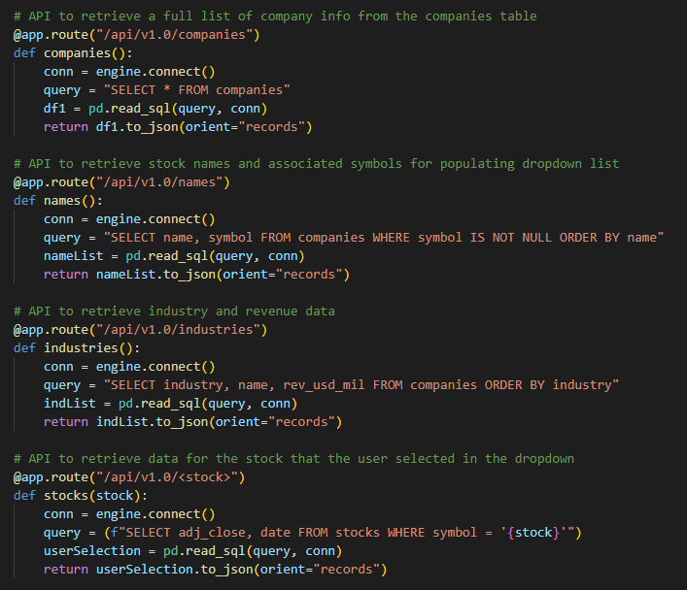
Four Python Flask-powered APIs

Slide 9

Visualization:
Leaflet Heat Map

Slide 10

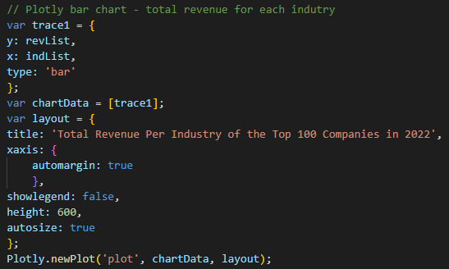
Visualization:
Plotly Bar Chart

Slide 11


Visualization:
Dropdown Selection and Plotly Line Chart

Slide 12
Demo Time

Slide 13
Thanks!

